Slide 1

Topic 7
Switch Statement

Slide 2
Switch

Slide 3
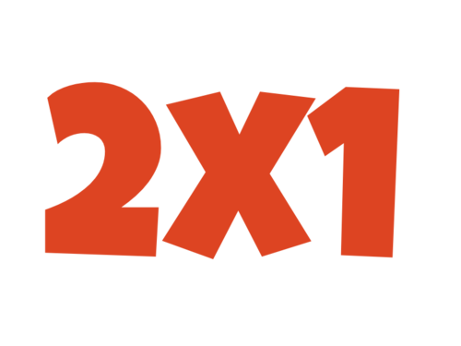



Lunes
Martes
Miércoles y Jueves
Viernes
Sábado y Domingo
No hay promociones!
$49.00
$35.00
$30.00

Slide 4
Usando IFs
Scanner keyboard = new Scanner(System.in); System.out.print("What day is today?: "); String day = keyboard.nextLine(); if (day.equals("Monday")){ System.out.println("2x1 in movie tickets!"); }
if (day.equals("Tuesday")){ System.out.println("Popcorn for $49.00"); }
if (day.equals("Wednesday") || day.equals("Thursday")){ System.out.println("Movie tickets for $35.00"); }
if (day.equals("Friday")) System.out.println("Any coffee for $30.00"); }
if (day.equals("Saturday") || day.equals("Sunday")){ System.out.println("No promos!"); } keyboard.close();

Slide 5
Usando IFs
Problemas:
El programa no detecta escenarios en donde los días están mal escritos.
Debemos agregar una condición por cada caso que debamos considerar.
Largo y difícil de leer.
Scanner keyboard = new Scanner(System.in); System.out.print("What day is today?: "); String day = keyboard.nextLine(); if (day.equals("Monday")){ System.out.println("2x1 in movie tickets!"); }
if (day.equals("Tuesday")){ System.out.println("Popcorn for $49.00"); }
if (day.equals("Wednesday") || day.equals("Thursday")){ System.out.println("Movie tickets for $35.00"); }
if (day.equals("Friday")) System.out.println("Any coffee for $30.00"); } if (day.equals("Saturday") || day.equals("Sunday")){ System.out.println("No promos!"); } keyboard.close();

Slide 6
Usando IF-ELSE
Scanner keyboard = new Scanner(System.in);
System.out.print("What day is today?: ");
String day = keyboard.nextLine();
if (day.equals("Monday")){
System.out.println("2x1 in movie tickets");
} else if (day.equals("Tuesday")){
System.out.println("Popcorn for $49.00");
} else if (day.equals("Wednesday") || day.equals("Thursday")){
System.out.println("Movie tickets for $35.00");
} else if (day.equals("Friday")){
System.out.println("Any coffee for $30.00");
} else if (day.equals("Saturday") || day.equals("Sunday")){
System.out.println("No promos :(");
} else {
System.out.println("Invalid day! try again");
}
keyboard.close();

Slide 7
Usando IF-ELSE
Problemas:
Debemos agregar una condición por cada caso que debamos considerar.
Largo y difícil de leer.
Scanner keyboard = new Scanner(System.in);
System.out.print("What day is today?: ");
String day = keyboard.nextLine();
if (day.equals("Monday")){
System.out.println("2x1 in movie tickets");
} else if (day.equals("Tuesday")){
System.out.println("Popcorn for $49.00");
} else if (day.equals("Wednesday") || day.equals("Thursday")){
System.out.println("Movie tickets for $35.00");
} else if (day.equals("Friday")){
System.out.println("Any coffee for $30.00");
} else if (day.equals("Saturday") || day.equals("Sunday")){
System.out.println("No promos :(");
} else {
System.out.println("Invalid day! try again");
}
keyboard.close();

Slide 8
Switch
Un switch es una instrucción condicional que nos permite determinar múltiples caminos a partir de una expresión integral.
Podemos utilizar una variable numérica o texto para generar los distintos caminos.
El switch está compuesto por tres elementos:
Switch
Case
Default (opcional)

Slide 9
Especificamos la condición usando:
switch(<expresion integral>)
Scanner keyboard = new Scanner(System.in);
System.out.print("What day is today?: ");
String day = keyboard.nextLine();
switch(day){
case "Monday":
System.out.println("2x1 in movie tickets");
break;
case "Tuesday":
System.out.println("Popcorn for $49.00");
break;
case "Wednesday":
System.out.println("Movie tickets for $35.00");
break;
case "Friday":
System.out.println("Any coffee for $30.00");
break;
}
keyboard.close();
Especificamos cada camino utilizando la sintaxis:
case <caso>:

Slide 10
Scanner keyboard = new Scanner(System.in);
System.out.print("What day is today?: ");
String day = keyboard.nextLine();
switch(day){
case "Monday":
System.out.println("2x1 in movie tickets");
break;
case "Tuesday":
System.out.println("Popcorn for $49.00");
break;
case "Wednesday":
System.out.println("Movie tickets for $35.00");
break;
case "Friday":
System.out.println("Any coffee for $30.00");
break;
}
keyboard.close();
La sentencia break se agrega para salir del bloque switch {}
Si no agregamos esta instrucción, el programa se saltaría a los siguientes case

Slide 11
Scanner keyboard = new Scanner(System.in);
System.out.print("What day is today?: ");
String day = keyboard.nextLine();
switch(day){
case "Monday":
System.out.println("2x1 in movie tickets");
break;
case "Tuesday":
System.out.println("Popcorn for $49.00");
break;
case "Wednesday": case "Thursday":
System.out.println("Movie tickets for $35.00");
break;
case "Friday":
System.out.println("Any coffee for $30.00");
break;
case "Saturday":
case "Sunday":
System.out.println("No promos :(");
break;
default:
System.out.println("Invalid day! try again");
}
keyboard.close();
Si queremos especificar múltiples casos con la misma lógica, podemos indicar
case <scenario1>: case <scenario2>:
case <scenario3>: code; break;
También podemos especificar un caso por default:
default:

Slide 12
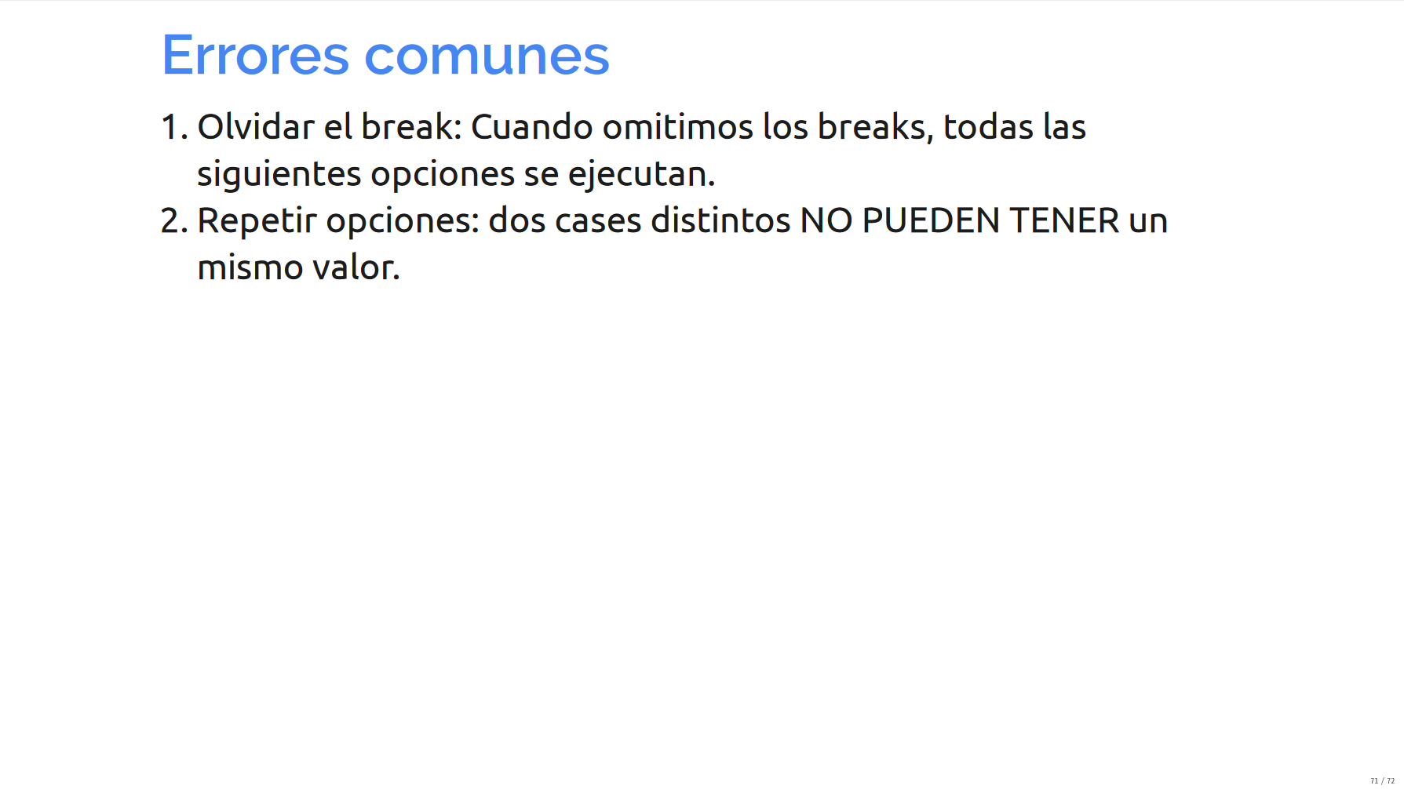

Slide 13
